Slide 1
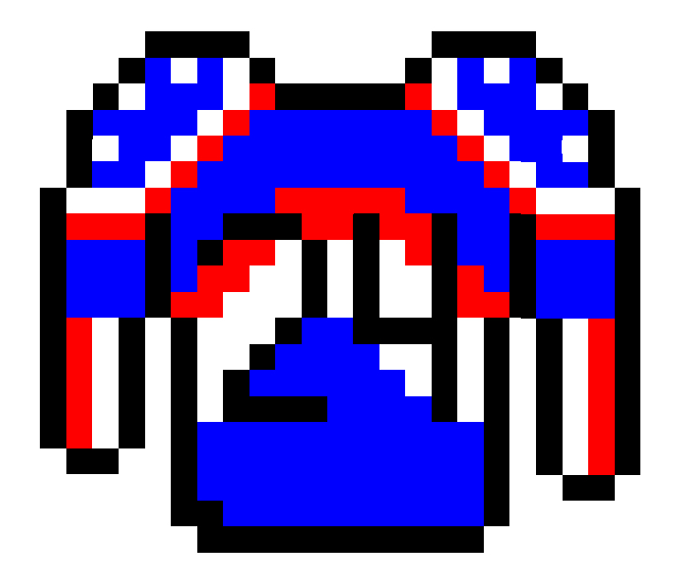
Retro-Hockey
By: Robbie Reinhardt, Nathan Sawyer, Dylan Gomez, Ananda Shrestha, Bigyan, and Matt

Slide 2
Team Members/ Tasks
TL1 - Puck Movement - Matt
TL2 - Background and Audio - Bigyan
TL3 - Offense System - Nathan
TL4 - Screens - Ananda
TL5 - Defense System - Robbie
TL6 - Shooting and Passing / Player Control - Dylan

Slide 3
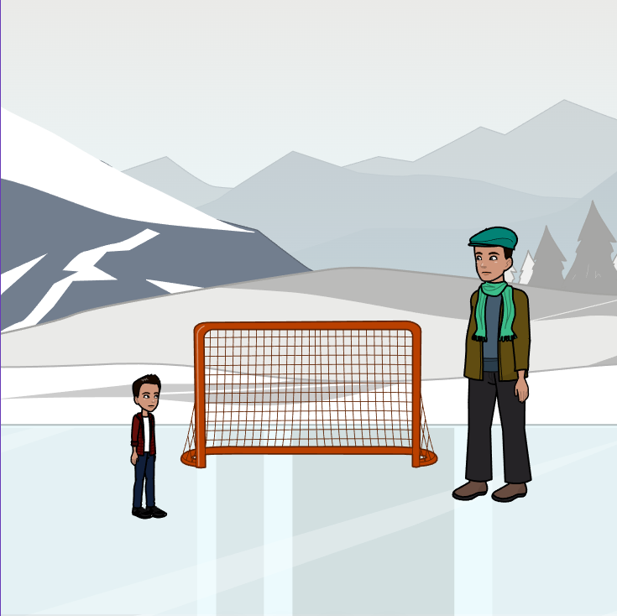
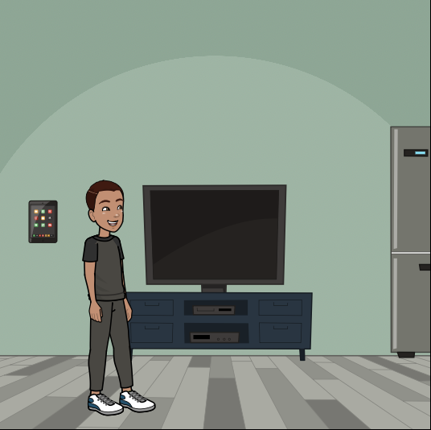
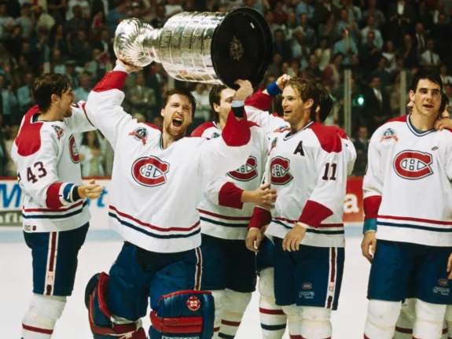
The Journey To The Stanley Cup
As a kid, I practiced outside every day, dreaming of being the best….
Man, I’m going to be just like them someday. I just need to keep getting better

Slide 4
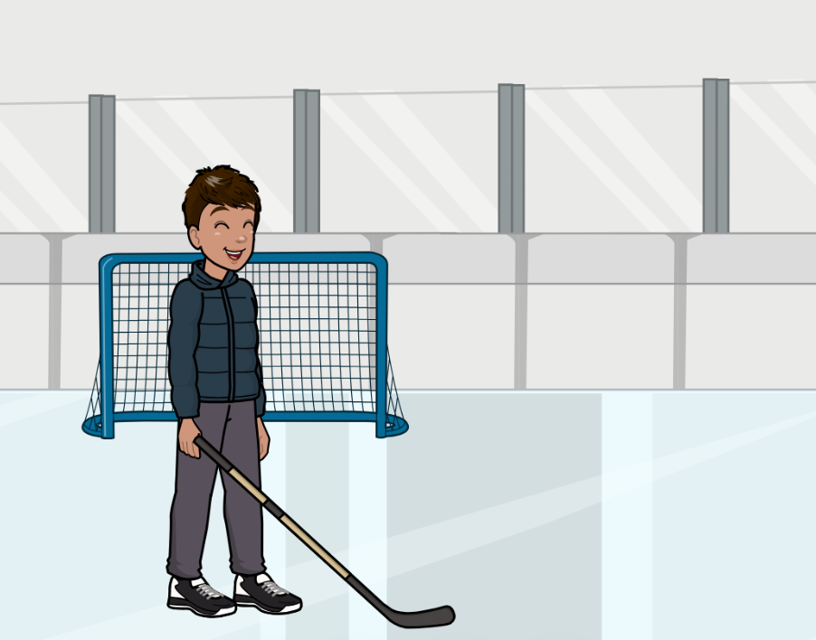

The Journey To The Stanley Cup
Dylan falls in love with hockey
High School MVP! Celebrating the sweet taste of victory and a season well-earned. 2024 Champions!

Slide 5
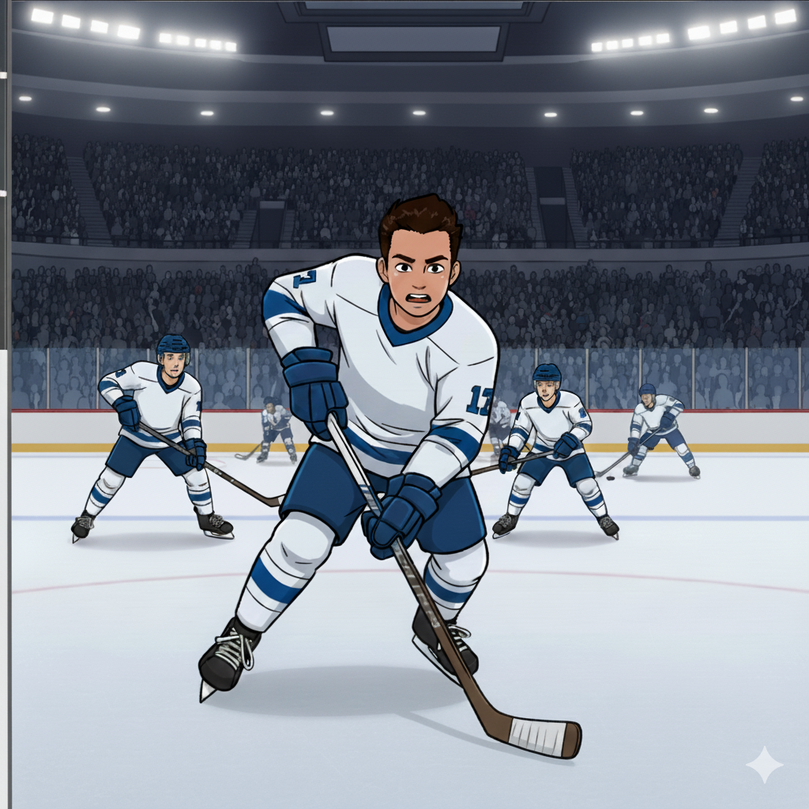
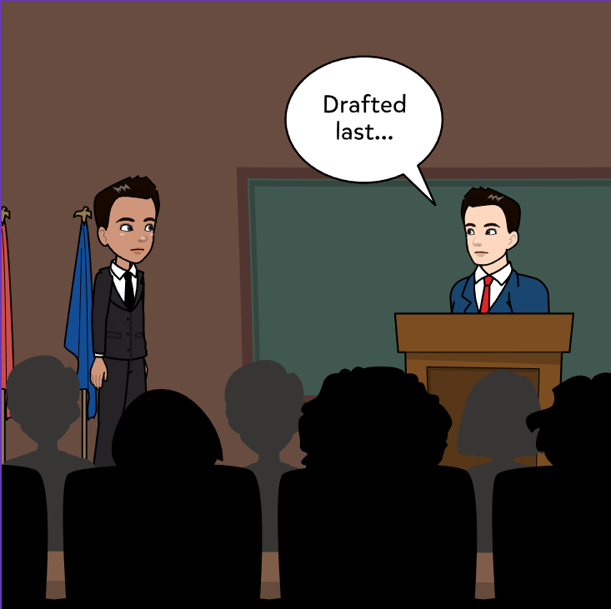
Journey To The Stanley Cup
In college, he shines against tough competition, becoming a standout player and drawing scouts toward the pro draft.

Slide 6
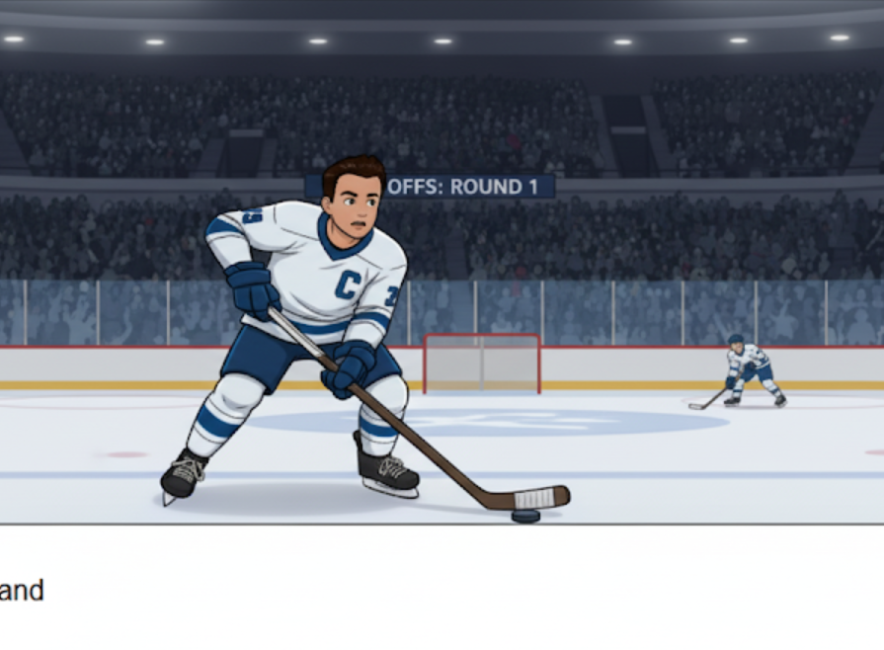
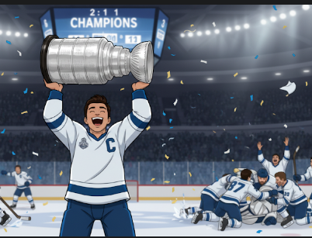
The Journey To The Stanley Cup

Slide 7
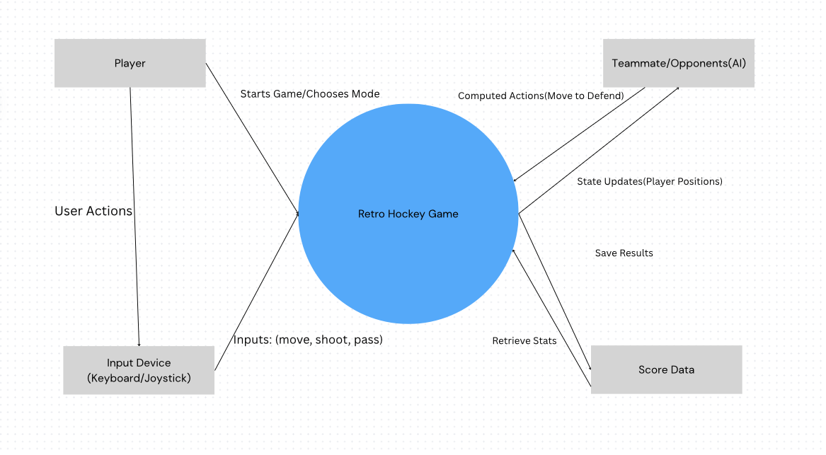
Context Diagram

Slide 8
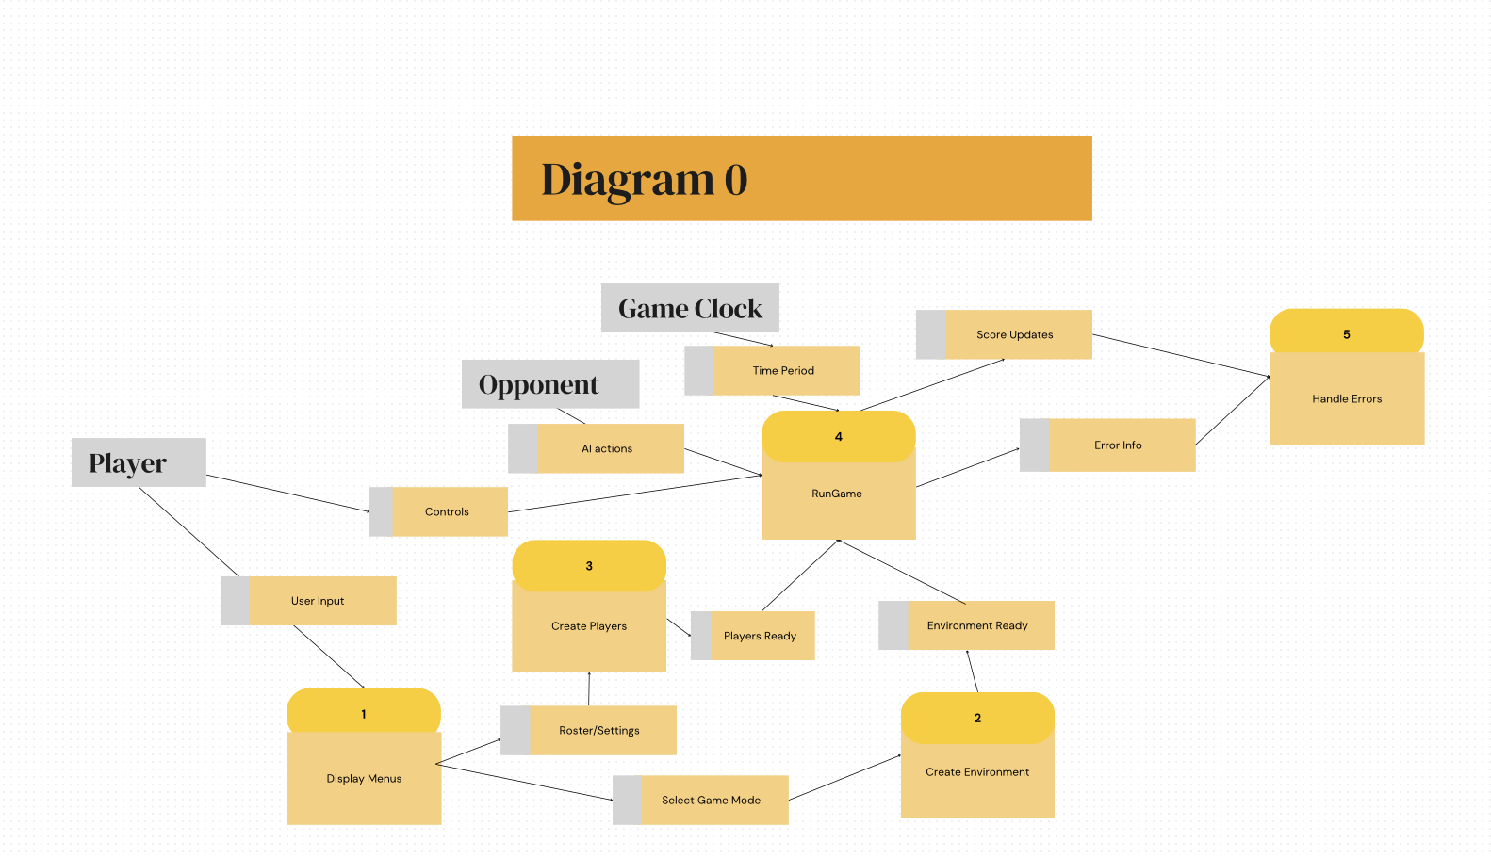

Slide 9
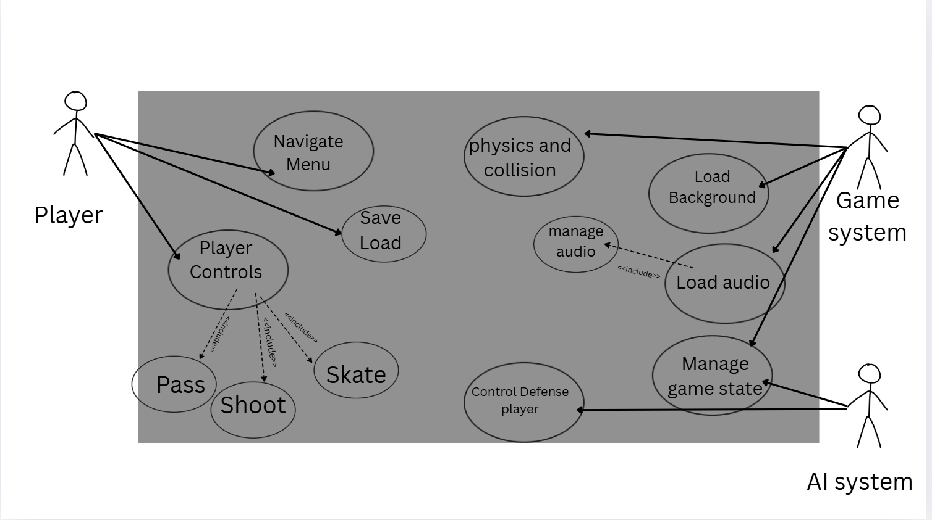
Global Use Case
Three Primary Actors: 1. Player
2. AI system,
3. Game System
Core Functionality:
1. Menu Navigation,
2. Player Controls,
3. AI Defense,
4. Audio/Visual Management

Slide 10
Puck Movement (TL1 Matthew Fry)
Hello, My name is Matthew Fry and for the retro hockey project I am doing the Puck movement, including passing the puck between players, and interception of the puck during a pass. It features general physics like sliding, bouncing off walls and responding to the player. The puck will follow calculated trajectory based on many variables. There is going to be two different pucks, a light puck and a heavy puck. Each unique in the way it works in the game.

Slide 11
Role Complexity and Priority (TL1 Matthew Fry)
The puck movement feature is a high-priority component and is essential to the core gameplay. The game wouldn't feel fun or engaging without a puck that slides across the ice and interacts with environment properly. General complexity Is somewhat high just to make it work with all the players and function properly

Slide 12
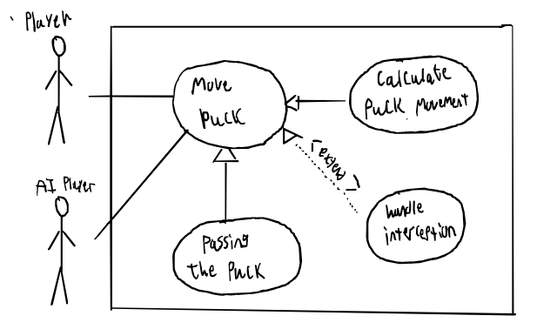
Use case diagram (TL1 Matthew Fry)
The use case diagram will show how the puck movement will work.
- Two actors the players and the air
- Pass the puck
- calculate puck movement
- handle interception

Slide 13
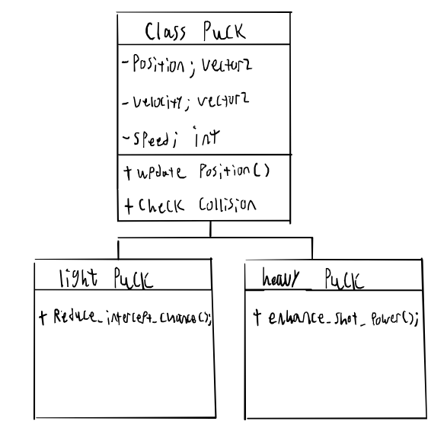
Class Diagram (TL1 Matthew Fry)
This is the class diagram, with the two different kinds of pucks, there functions will be virtual in the abstract puck class and require dynamic binding. And these will be done using singleton and private class data.

Slide 14
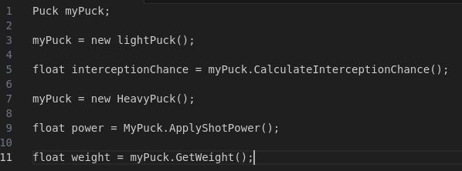
Sudo Code (TL1 Matthew Fry)
This shows how the static type (known at compile time) and the dynamic type (runtime type) will potentially work. Assign a subclass instance (runtime), call virtual method using dynamic binding

Slide 15
Components And Questions (TL1 Matthew Fry)
Puck will adapt to difficulty of the game
Will check and validate AI and player positions, puck position, interception probabilities, and other mechanics.
Any questions?

Slide 16
TL2-Bigyan, Processes
My Processes:
Number 2
Number 4 and 5

Slide 17
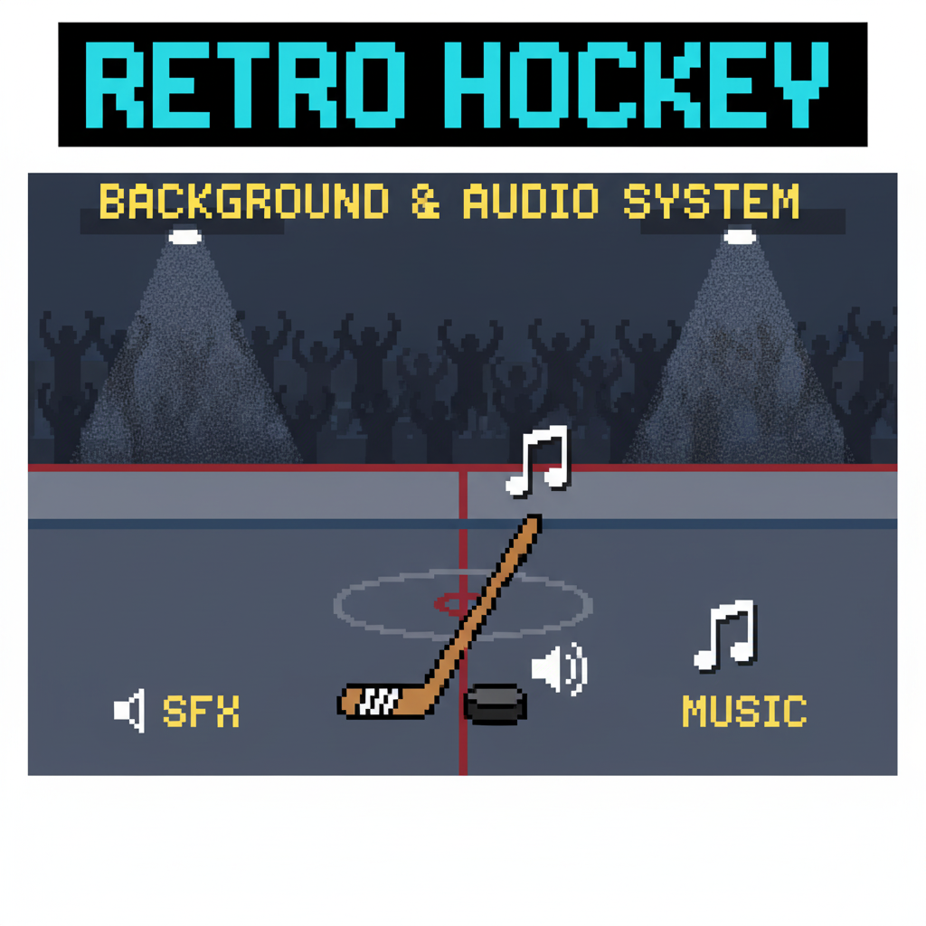
Background and Audio, TL2- Bigyan
Intro : Bigyan Karki
Part: Audio and Background Management
Features: render static rink environment, play background music, add event sounds, add crowd reaction sound
Priority : Medium

Slide 18
TL2 Bigyan- Complexity
Complexity Level:
Moderate, due to asset loading, event-driven sound management, and system fallbacks.
More complex than UI menu/navigation logic (e.g., button selection, save/load functionality).
Less complex than AI-based systems like automated defense logic or real-time puck decision-making (e.g., passing, shooting).

Slide 19
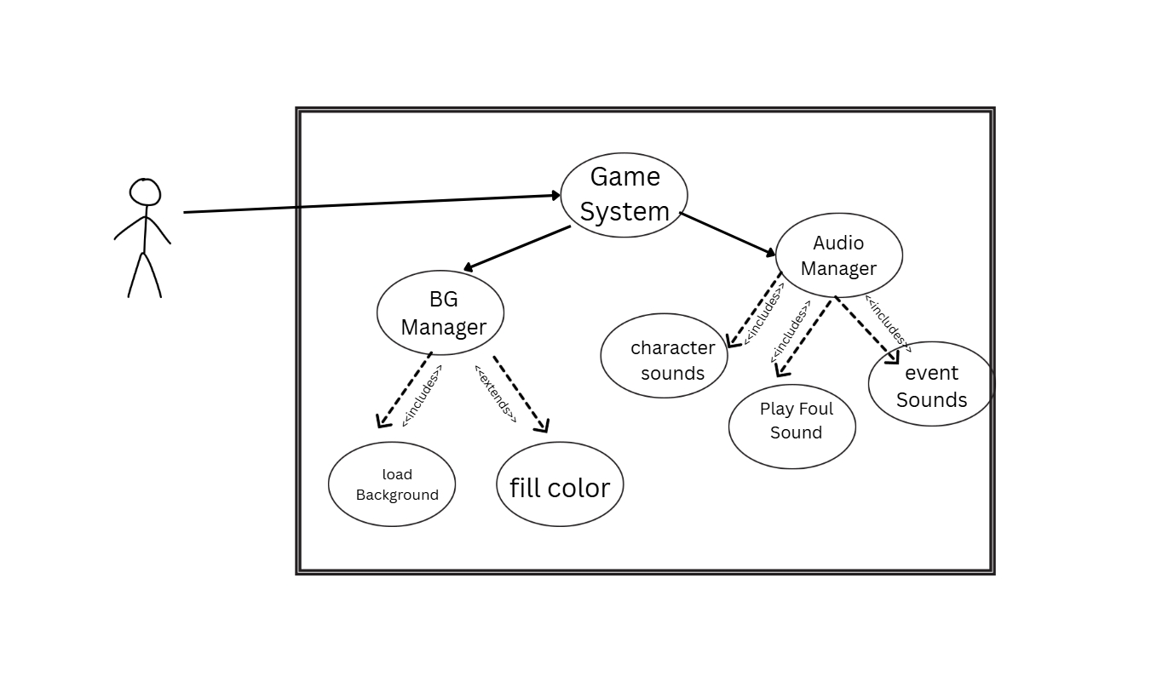
TL2 Bigyan - Use Case Diagram
Actor : Player
Core System: Game system
Background Manager
Audio Manager

Slide 20
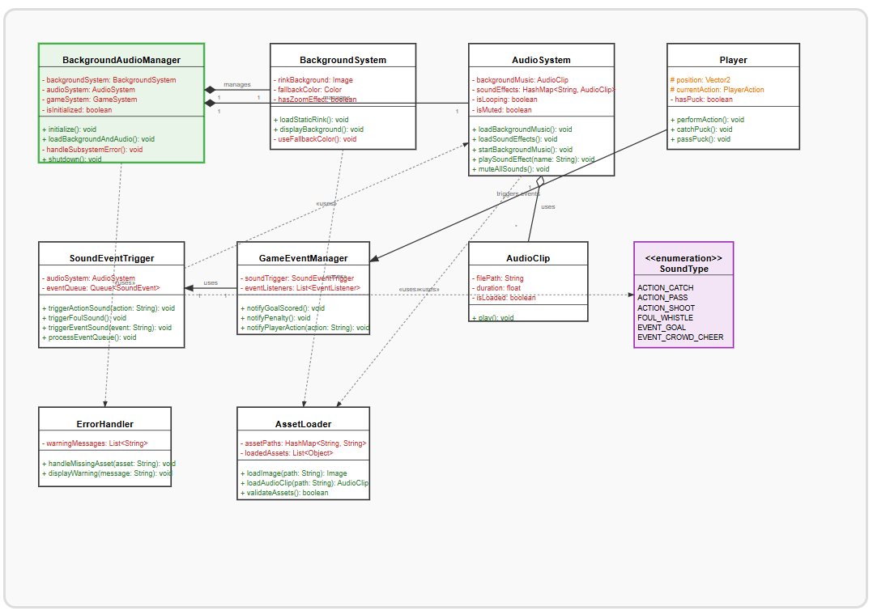
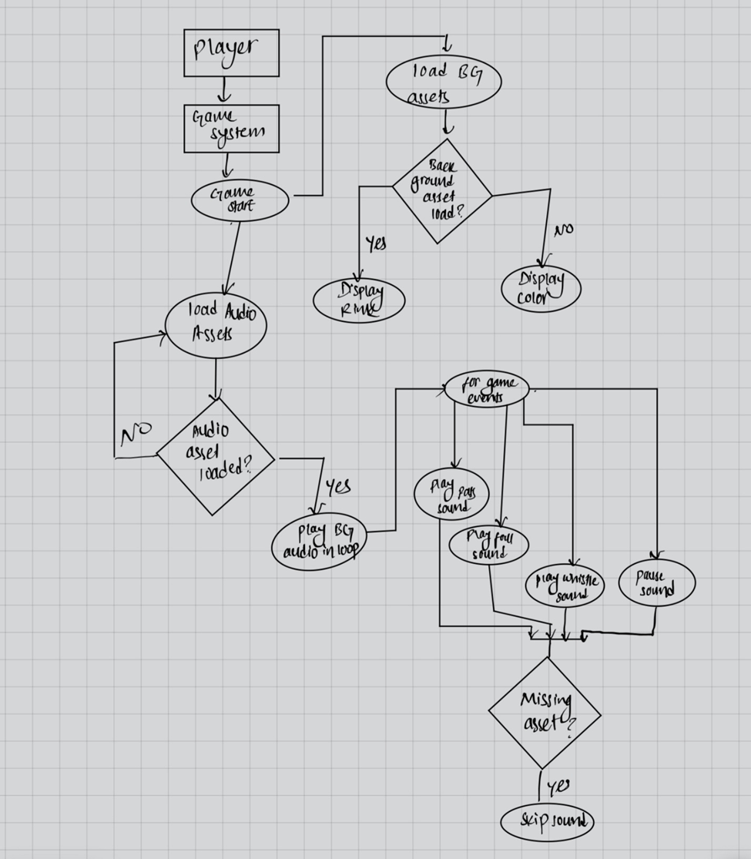
TL2 - Bigyan, Class Diagram
Background Asset Flow
Audio Asset Flow
Game event & Sound Handling
Fall Back Mechanism for missing assets

Slide 21
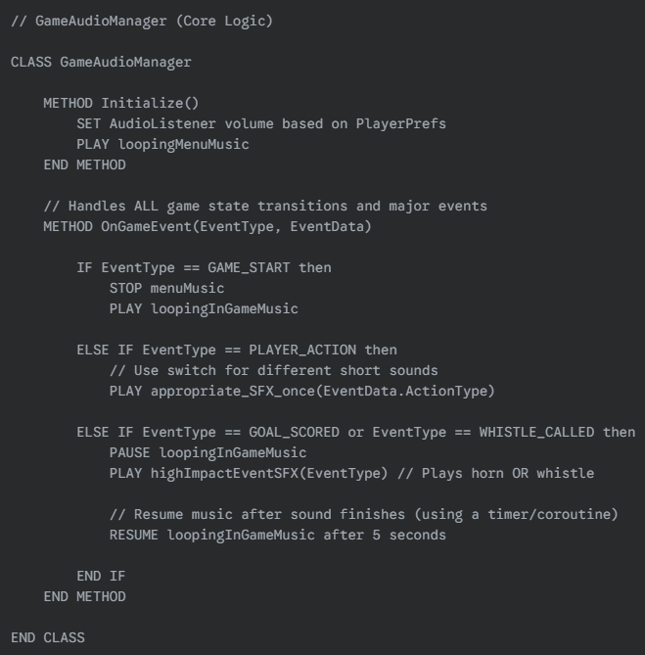
TL2- Bigyan Karki, Pseudo-Code
GameStart: ShowRink, PlayMusic(loop)
Goal: PlaySound(CrowdCheer)
Foul: PlaySound(Whistle)
Pass/Shoot: PlaySound(StickHit)
Pause/Res.: ToggleMusic()
Exit: StopMusic()

Slide 22
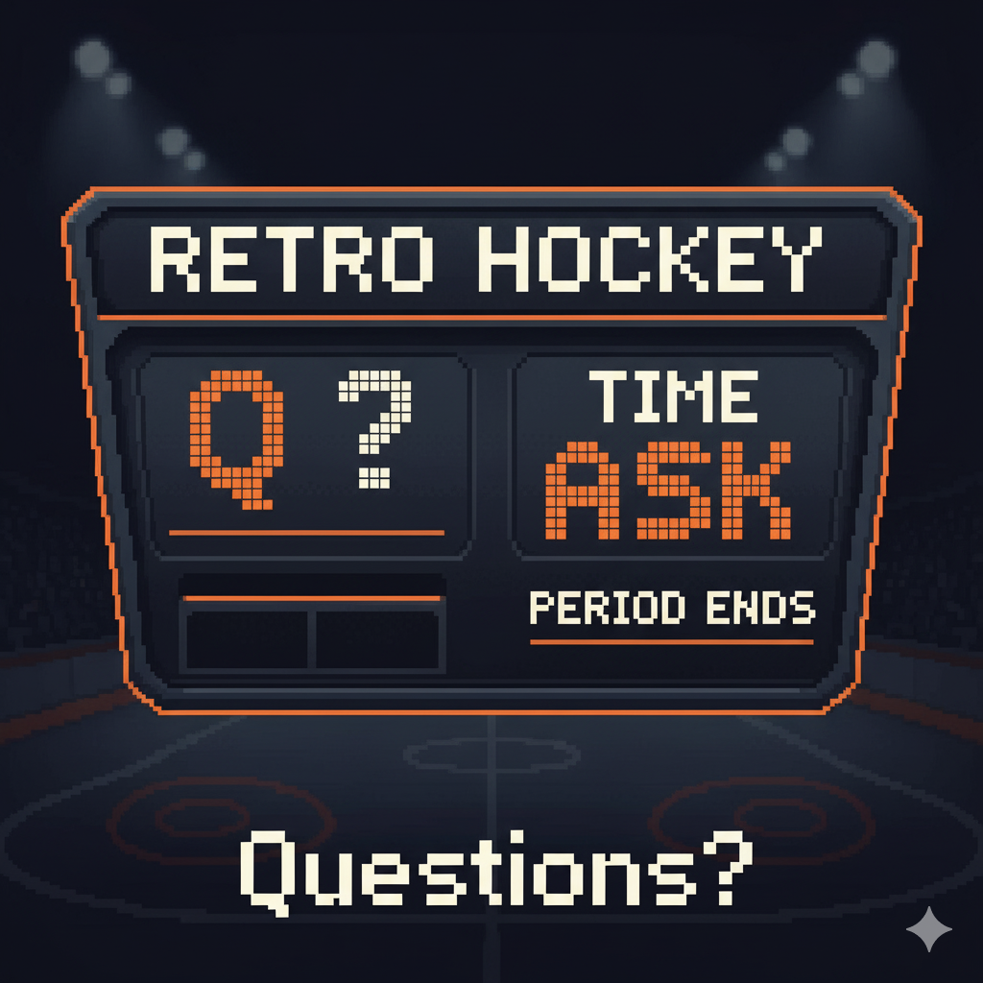
TL2-Bigyan, Questions?
?

Slide 23
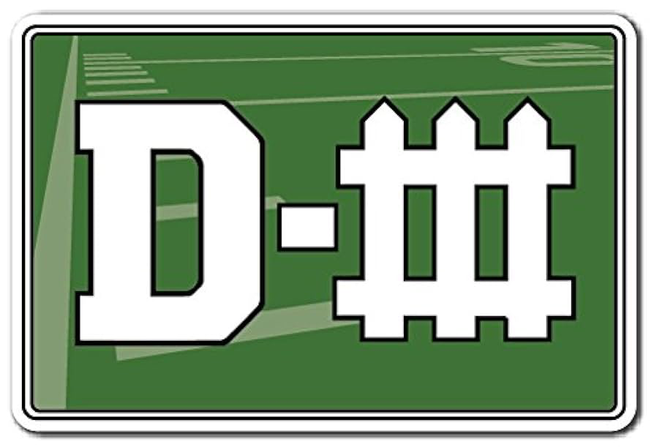
Automated Defense System (TL5 - Robbie Reinhardt)
Hello, my name is Robbie Reinhardt, and for the Retro Hockey project, I am the lead developer for the Automated Defense System (ADS). My role is to create a dynamic and intelligent AI that controls the defensive players for the computer-controlled team, providing a realistic and challenging opponent for the player.

Slide 24
Role, Priority, Complexity (TL5 - Robbie Reinhardt)
My feature focuses around a component of the AI control system. It takes in real time in game data, like player and puck position, and outputs commands to the automated 5 player defense
The priority for this is 1: Must Have
Not only is the defense required for a functional game but it is the backbone of the campaign option, the Road to the Stanley Cup mode. Without it the game would lack any competitive edge
The complexity of this section is pretty high. The main challenge is creating a believable and scalable AI that can anticipate player movements.

Slide 25
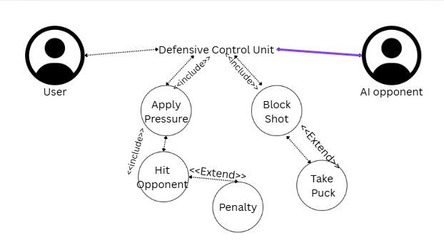
The Defense Use Case (TL5 - Robbie Reinhardt)
This use case diagram illustrates how the Automated Defense System works. The AI Opponent is the actor our system is reacting to.
The main use case is Control Defensive Player. It includes other use cases like Apply Pressure And Block Shot, which are mandatory parts of the AI's logic when defending.
It extends to Foul, an optional and less common action that can occur when the AI attempts a Tackle Opponent.

Slide 26
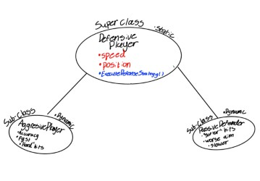
Class Diagram (TL5 - Robbie Reinhardt)

Slide 27
Dynamic & Static Building (TL5 - Robbie Reinhardt)
The Automated Defense System is complex enough to require design patterns like Singleton and Private Class Data because the system has to manage shared resources and maintain a coincident state across the entire game. For example:
The AI needs to make decisions about player position
Take in the puck position
Analyze the offense
Make decisions based off all three variables

Slide 28
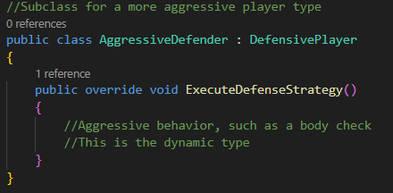
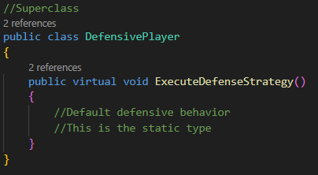
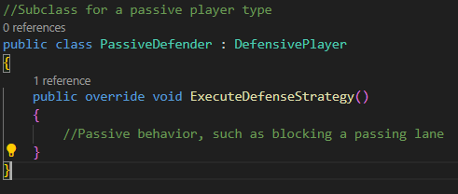
Pseudo-Code (TL5 - Robbie Reinhardt)

Slide 29
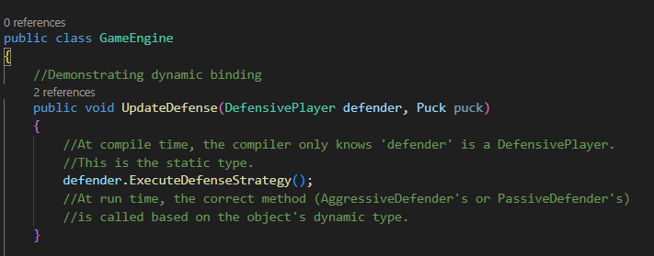
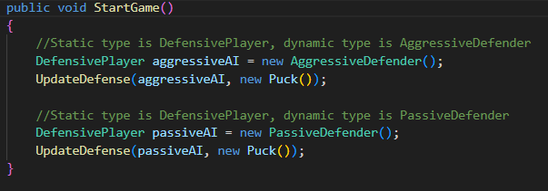
Pseudo-Code (TL5 - Robbie Reinhardt)

Slide 30

Key Components and Questions (TL5 - Robbie Reinhardt)
The feature's logic can be visualized with a decision tree, where the AI's strategy is determined by the game's difficulty level (Easy, Medium, Hard).
Our automated unit tests will focus on validating the AI's strategic positioning and pass interception abilities to ensure it's both functional and challenging.
I'm now ready to answer any questions you may have about the Automated Defense System.

Slide 31

Automated Offense System - TL3 - Nathan
Hello, my name is Nathan Sawyer, and for the Retro Hockey project, I am the lead developer for the Automated Offense System (AOS). My role is to create a dynamic and intelligent AI that controls the offensive players other than the player, providing a realistic and challenging opponent for the player’s defense. The offense will also be an aid to the player at the same time.

Slide 32
Role, Priority, Complexity - TL3 - Nathan
This features interprets live game data, like player position, puck position, and direction to pick the offense’s next best choice
The priority is 1. A functional offense must be present
The complexity of this piece is high. I will implement a zone or man coverage “beater” to get player’s open depending on the coverage that is played.

Slide 33
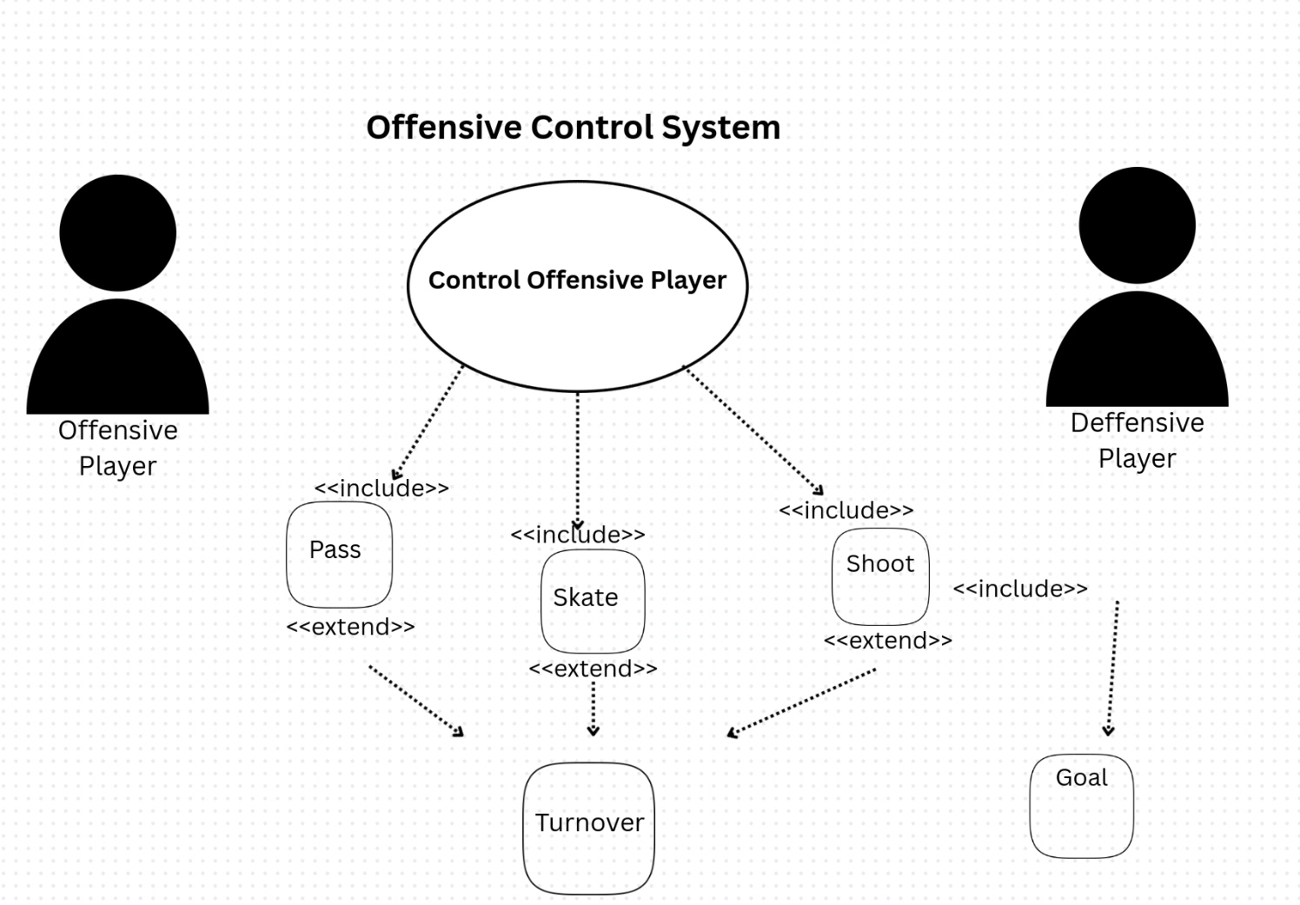
Offensive Use Case - TL3 - Nathan
This illustrates the current control structure of the offense.
Shoot can result in a goal, but can also result in a turnover.
All other actions can result in a turnover.

Slide 34
Code Building - TL3 - Nathan
The offensive system is also complicated enough to require classes to hold shared information. For example:
Offense needs to know which “play” is currently being used
Offense needs to analyze puck position
Offense must analyze player position
Must make decisions on all variables

Slide 35
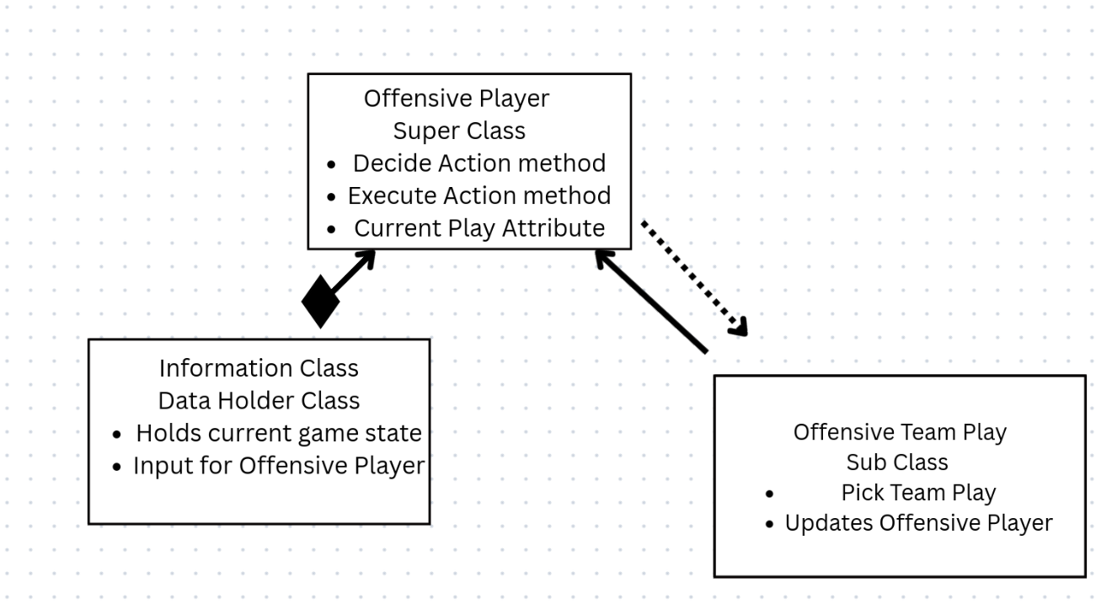
Class Diagram - TL3 - Nathan

Slide 36
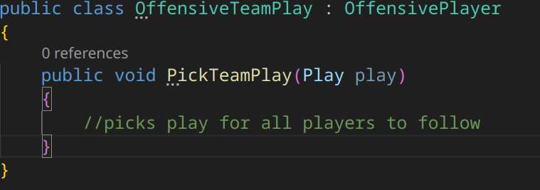
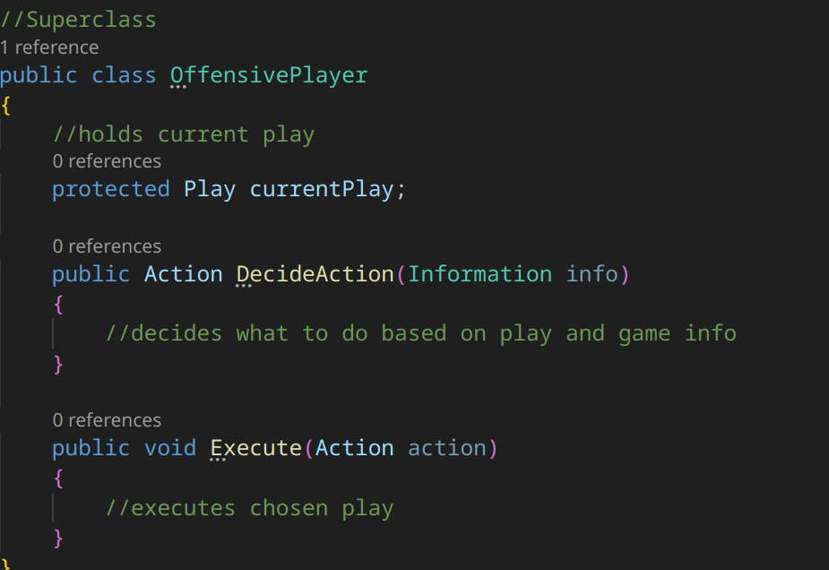
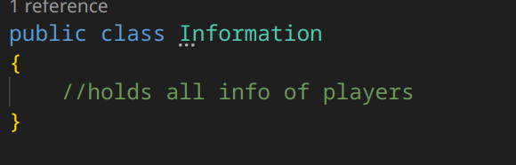
Pseudocode - TL3 - Nathan

Slide 37
Extra Info - TL3 - Nathan
The logic for this feature can also be visualized using a decision tree.
The speed of the player will change based on the difficulty, but the rest will stay the same.
Our tests will also focus on ensuring that the players make reasonable decisions based on the current game layout.
Any questions?

Slide 38
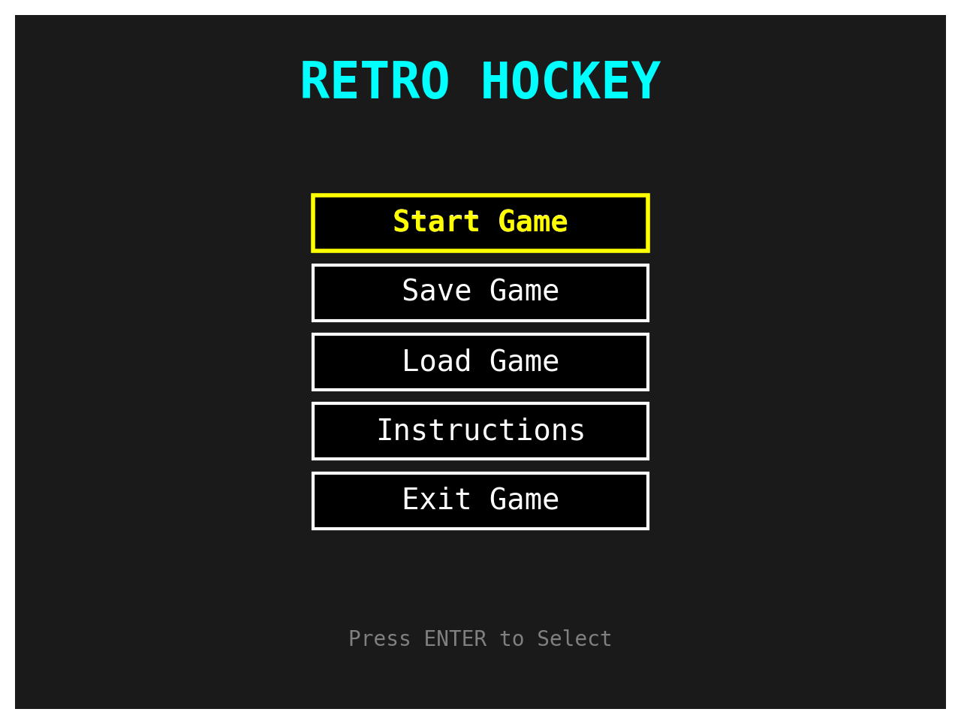
MENU (TL-4) INTRODUCTION, My Feature and Role in the Project (Ananda Shrestha)
Hello, my name is Ananda Lakshmi Shrestha. I am the developer responsible for designing and implementing the Menu Screen System in our Retro Hockey game.
The Menu Screen System serves as the hub of Retro Hockey.
Key Functions:
Start Game->Launches a new gameplay session
Save Game->Stores the current progress safely
Load Game->restores previously saved progress
Instructions->provides controls, rules, and tips
Exit Game->closes the application

Slide 39
MENU (TL-4) Priority and Complexity of my Feature
Priority: 1 Must have
It is fundamental to game flow because it allows:
Smooth transition into gameplay.
Management of progress through Save/Load.
Easy access to help through Instructions.
Moderate in Complexity
Challenges include:
Handling both keyboard and controller input.
Making sure Save/Load interacts correctly with the global Game State.
Designing a retro-style layout that scales across different resolutions.

Slide 40
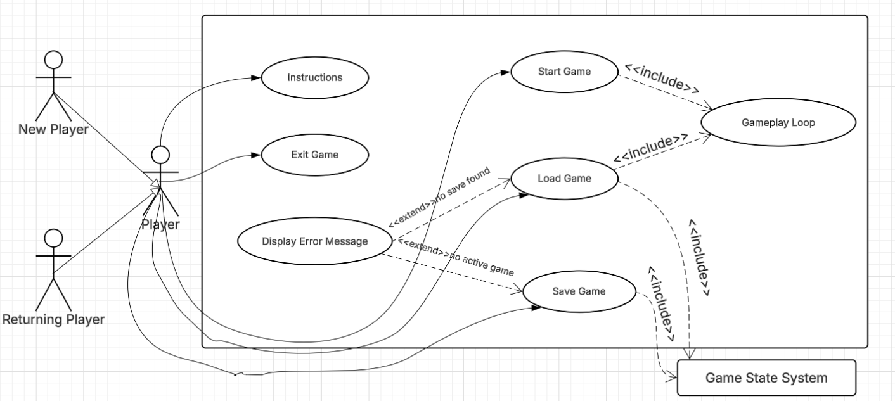
MENU (TL-4) Use Case Diagram
Shows how the player interacts with the Menu Screen System.
Scenario 1 (UC1):
Name: Navigate Menu Options
Summary: The player interacts with the menu to select an option (e.g., Start Game, Save Game, Load Game, Instructions, Exit).
Actors: Player
Preconditions: Menu screen has been loaded after the game launches.
Basic Sequence:
Menu loads and displays available options.
Player uses keyboard/controller to scroll through options.
Player highlights a desired option.
Player confirms selection (Enter/Controller button).
Exceptions:
Step 2: Player provides no input (menu remains idle).
Step 4: Invalid input is given (ignored, menu stays active).
Postconditions: The selected option triggers its corresponding function (e.g., start game, save, load, exit).
Priority: 1
Use Case Diagram 2: Save and Load Game
Scenario 2 (UC2):
Name: Save/Load Game Functionality
Summary: Player selects Save Game or Load Game from the menu to store or retrieve their game progress.
Actors: Player, Game State System
Preconditions: Game progress exists for saving or a saved game file exists for loading.
Basic Sequence:
Player selects Save or Load Game from the menu.
System prompts confirmation (optional).
If Save is chosen, the current game state is stored.
If Load is chosen, the stored game state is retrieved and gameplay resumes.
Exceptions:
Step 3: No active game to save → display error.
Step 4: No save file found → display error.
Postconditions: The game state is successfully saved or restored.
Priority: 1

Slide 41
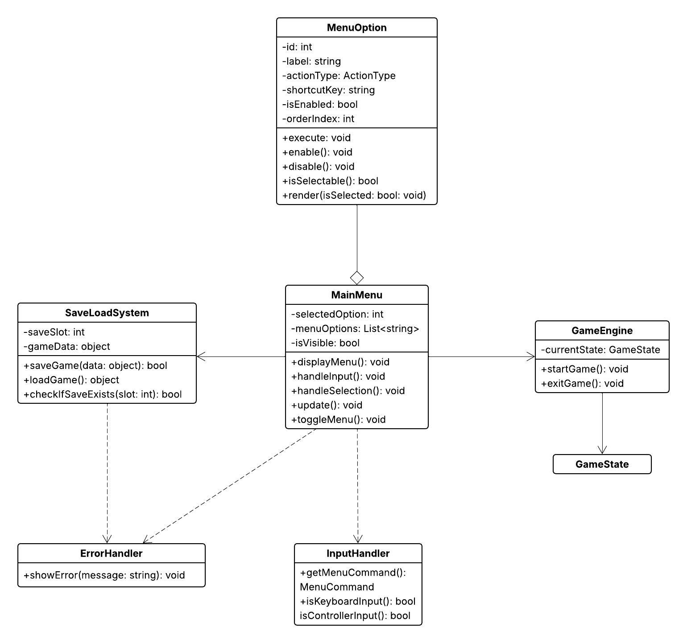
MENU (TL-4) Class Diagram

Slide 42
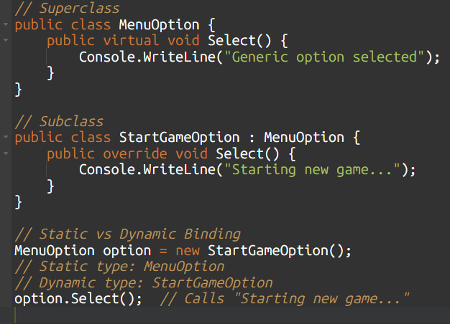
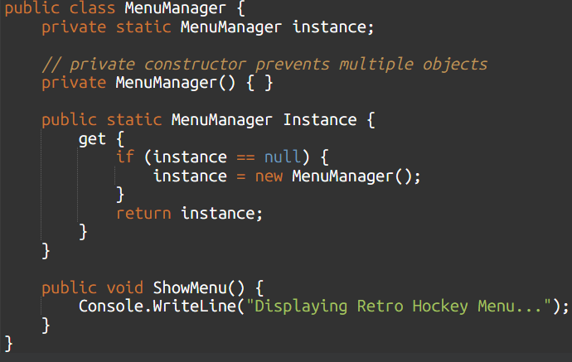
MENU (TL-4) Static vs Dynamic Binding and Design Pattern
Static Binding(Compile-Time): Variable type fixed at compile time.
Dynamic Binding(Run time): Actual object type decided when the program runs.
In Menu Screen, let's all option be treated as MenuOption but run the correct behavior at runtime.
Singleton Pattern
Fits Menu Screen
Prevents duplicate menus from running.

Slide 43

MENU (TL-4) Ananda Shrestha
Any Question?

Slide 44
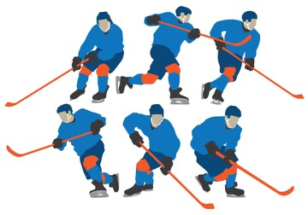
TL-6(Dylan Gomez) Shooting and Passing
Hello, my name is Dylan Gomez!
Player Interaction - Puck Control
High Priority - foundation of our game’s fun and flow
Responsibility - Passing Mechanics, shooting variants, and integration with the physics of our game

Slide 45
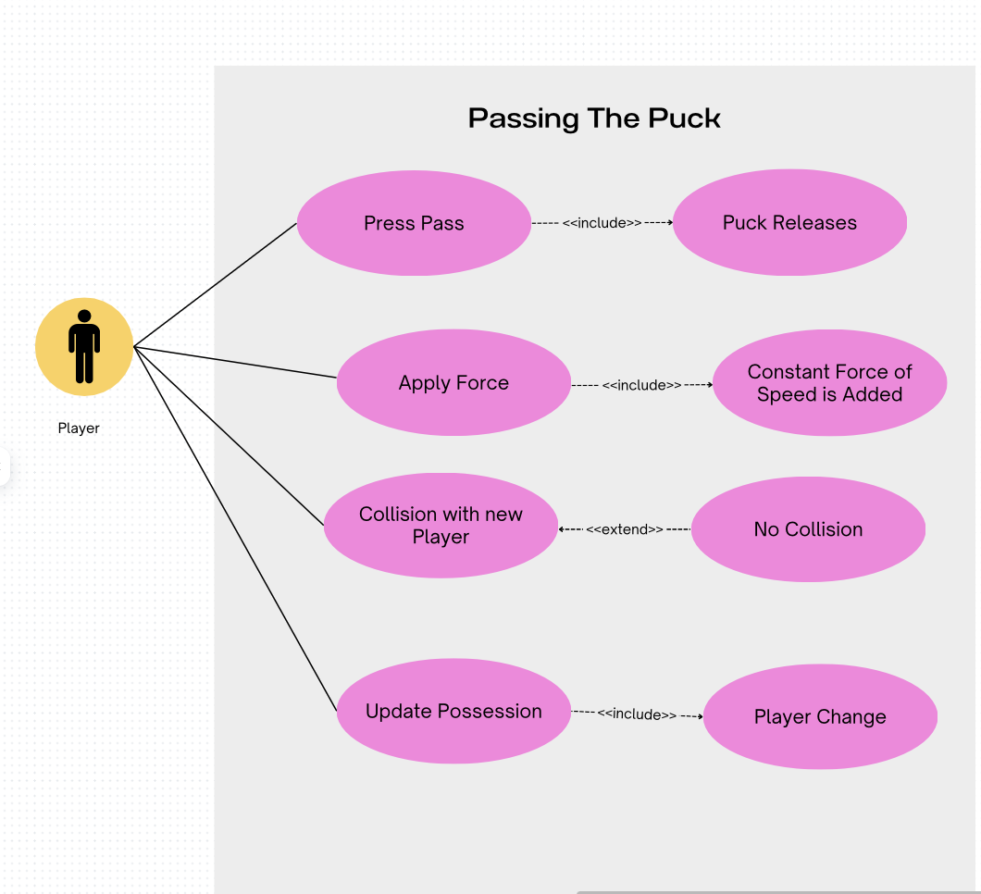
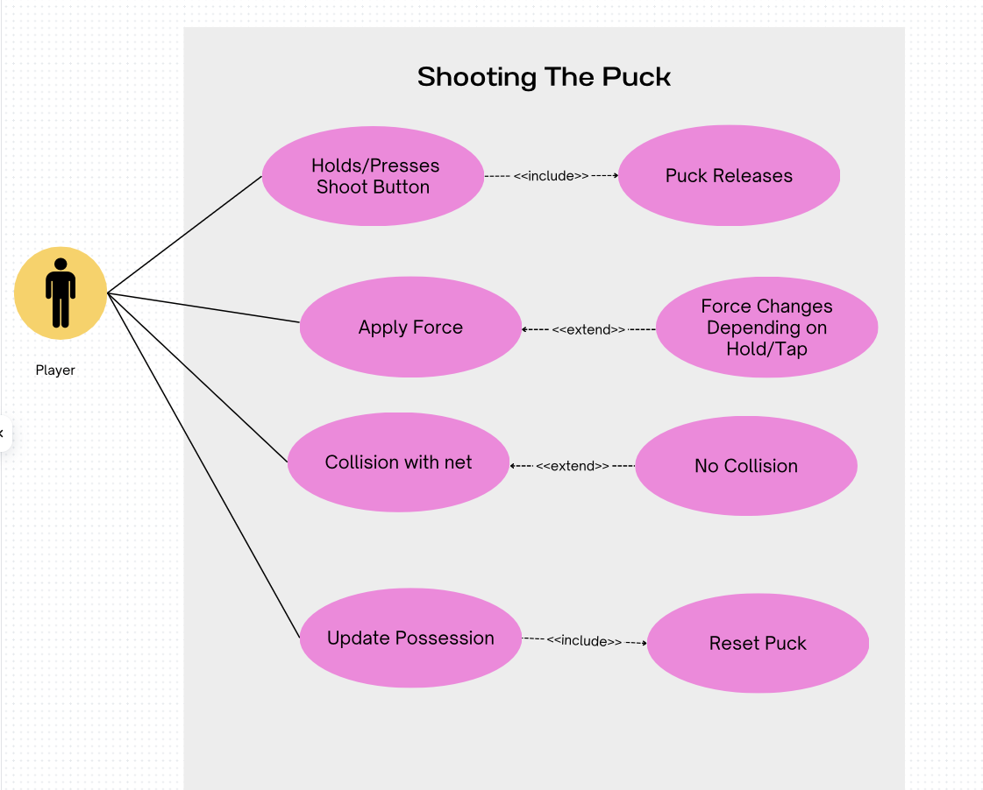
TL-6(Dylan Gomez) Use Case Diagrams

Slide 46
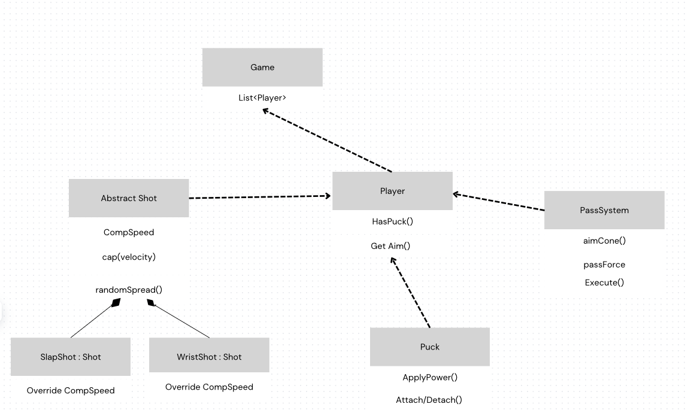
TL-6(Dylan Gomez) Class Diagram

Slide 47
TL-6(Dylan Gomez) Complexity and Time of Tasks
Task Time(Hours) Complexity
Shooting System | 12 | Very Hard
Passing System | 16 | Very Hard
Physics/Possession | 12 | Hard
Prefabs and Documentation | 4 | Easy
Testing (Edit+Play Mode) | 8 | Medium

Slide 48
TL-6(Dylan Gomez) Questions

